Slide 1
Care of Self:
A Practical Model for Health and Spiritual Wellness
Luann Drolc Fortune, PhD, LMT
Notes:
identify someone to help distribute handouts when it is time.
Circulate the sign up sheet for those who want copies of the presentation.

Slide 2

Mindful Moment
Notes:
Bring bells: starts with good breathing

Slide 3

Welcome and Introductions
I pray that you may enjoy good health and that all may go well with you, even as your soul is getting along well.”
– 3 John 1:2 NIV
Notes:
I am a pinch hitter-—challenge to demonstrate how Care of Self is sound Christian practice.

Slide 4

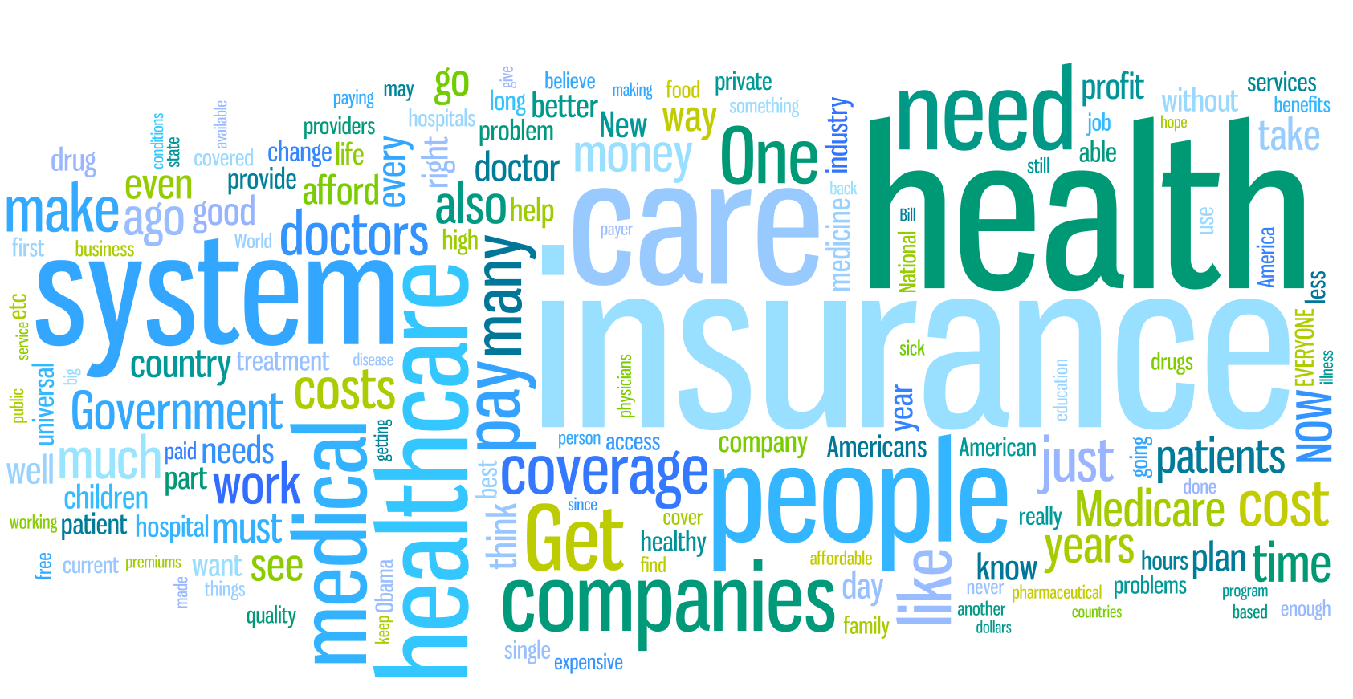
Overview:
What is Self-care?
What is Health?
This Photo by Unknown Author is licensed under CC BY-NC-ND
This Photo by Unknown Author is licensed under CC BY-NC-SA
Notes:
Connection to humanistic principles: being the best you can be. Wellness vs not ill

Slide 5
Chronic Conditions:
Opportunities for Self-care
Age >64 years
Age 18 – 64 years

Slide 6
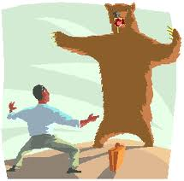
Wellness Culprit: The Stress Response
FIGHT OR FLIGHT
What happens
Bodily responses
Physiologic response to danger, threat, or stress
Arousal & preparation
Mediated by periorbital, frontal cortex, limbic system, hypothalamus, and autonomic nervous system
Biochemical changes flow through the entire body
↑ Survival-Oriented Decisions
↑ Adrenaline
↑ Blood Pressure
↑ Breathing & Heart Rate
↑ Muscle Tension
↓ Cortical Activity
↓ Intestinal Activity
↓ Peripheral Vision

Slide 7


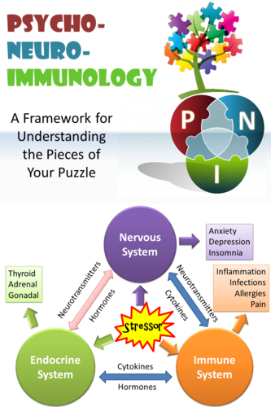
Psychoneuroimmunology (PNI)
Notes:
Cytokines are cell signaling molecules that aid cell to cell communication in immune responses and stimulate the movement of cells towards sites of inflammation, infection and trauma.

Slide 8
YOUR WHY: Purpose
Sustainable Self-care Practices:
7 Sources of Health Model*
Body
Mind
Creativity
7 Sources of Health
Emotions
*Based on model developed by R. Russo (2018)
Community
Environment
Notes:
In each source, share some research findings and suggest evidence based practices to strengthen that source-info is evidence based, detail in references (sign up), maybe not new to common sense but ground-breaking the research of health and wellness

Slide 9

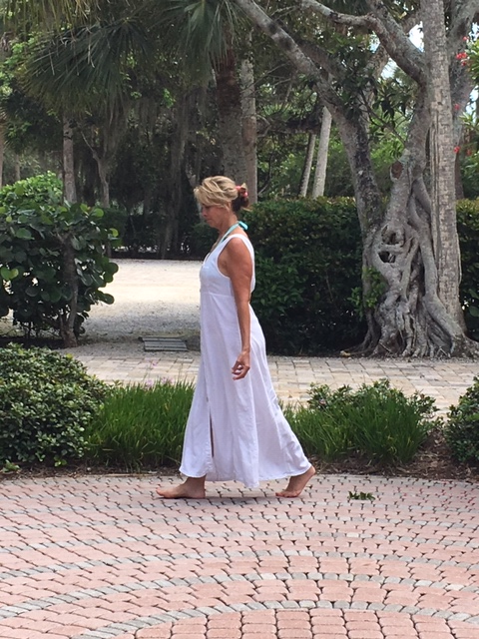
Your WHY:
Life Purpose
Beyond happiness, having a sense of purpose can
  increase your life by up to 7 years
  have a stronger immune system
  are at lower risk for chronic disease
If you are already crystal clear, then you can use the WHY skills to validate and strengthen your sense of purpose.
Skills to build your WHY:
  Self- coaching
  Sharing your Life Story
  “Crucibles”
  Being of Service

Slide 10
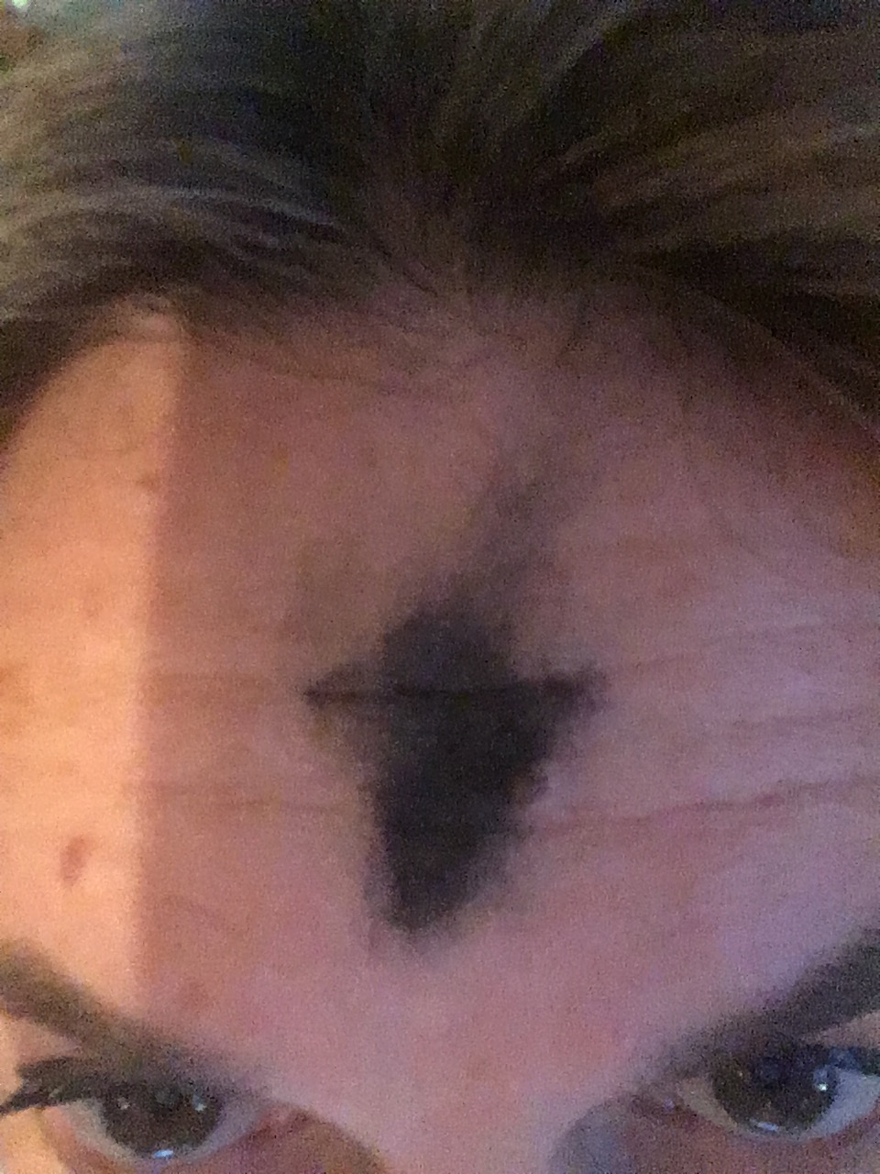
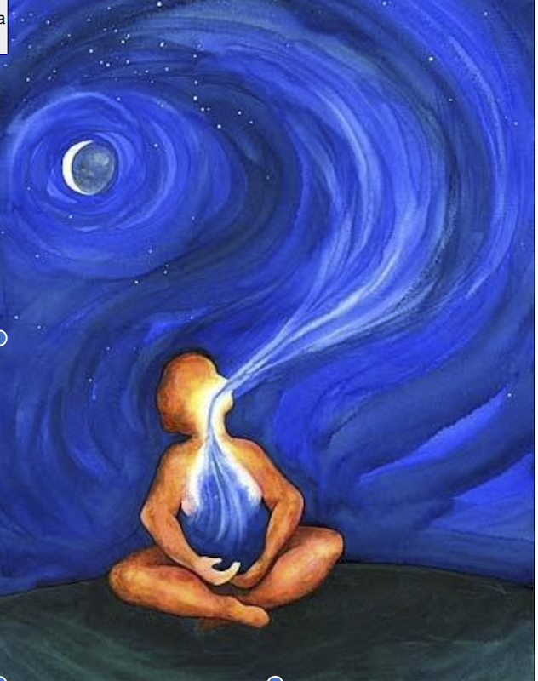
Physical Body
Attention to movement, sleep, and eating, all are interrelated
The quality and quantity of what you eat impacts your movement and sleep...sleep impacts movement and eating... movement impacts your eating and sleeping.
Skills you can learn to build your body:
  Movement of Spine
  Standing, posture
  Food = Medicine
  Healthy Sleep Habits
  Breathing
Notes:
Attention to movement, sleep, and eating.
All interrelated

Slide 11
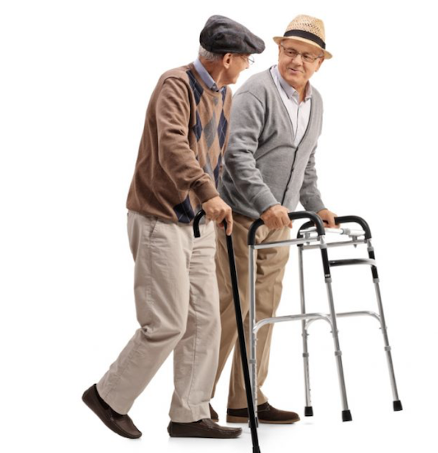

Power of Movement
Protects memory & thinking skills
Sitting-Is-The-New-Smoking
Sitting for 5 hrs per day = 5 yrs lower life expectancy
Moving every hour reduces chances of:
  Hypertension by 50%
  Diabetes by 30%
  Stroke by 27%
  Certain cancers by 25%

Slide 12

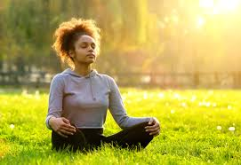
Mind
Involves your ability to channel your thoughts, attention and focus
Positive thoughts are highly correlated with better health
Intense prayer and meditation alter brain structure and function including perception of reality
Skills to build your mind:
  Meditation
  Life-long Learning
  Focus exercises
  Neurobics: Brain exercises
Research on meditation:
  Reduced fatigue and anxiety
  Improved visual-spatial processing, working memory, and executive functioning
  Improved attention & awareness, self-care & coping strategies
  Increased value of others
  Increased open-mindedness
  Reduced stress & anxiety
  Slows down aging
Notes:
Studies of meditating students report:

Slide 13
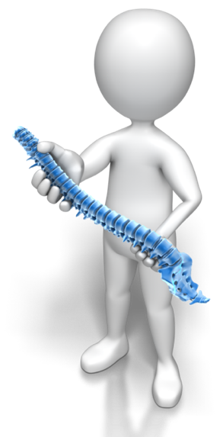
Practice: 7 Movements of the Spine
Extension from the ground
Front
Back
Laterally left
Laterally right
Twisting left
Twisting right

Slide 14
What is the evidence supporting moving the spine?
Based on Yoga research:
Invokes relaxation response in as little as 4 min.
Reduces pain, anxiety, depression
Promotes better sleep
Similar to yoga, moving the spine benefits:
high blood pressure
high blood sugar
Depression and anxiety
stress
arthritis
Cardio-vascular health
chronic pain management

Slide 15
Which sources of health did this one practice strengthen?
✔ Movement
✔ Breathing
✔ Awareness
✔ Focusing
✔ Standing
✔ NEAT
(Non-Exercise Activity Thermogenesis)
WHY
Body
7 Sources of Health
Mind
Creativity
Emotions
Community
Environment

Slide 16
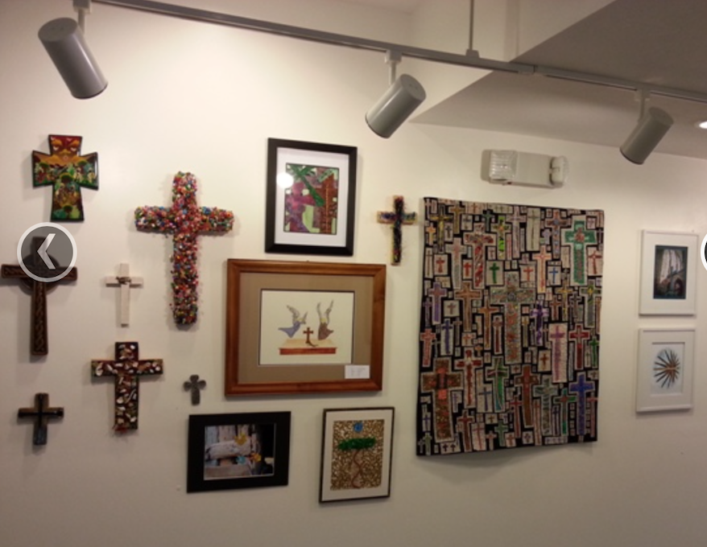

Creativity
What is vital or essential to you as a human being
In the literature, creativity is tied to spirit
Skills to build:
  Practice Ritual
  Writing, Journaling
  Storytelling
  Drawing, Crafts
  Music
  Dance
Art & expressive writing linked to mental health improvements (Stuckey & Nobel, 2010)
Oxytocin increases spirituality (Van Cappellen et al., 2016)
Spirituality linked to increased productivity & teamwork (Daniel, 2010)

Slide 17
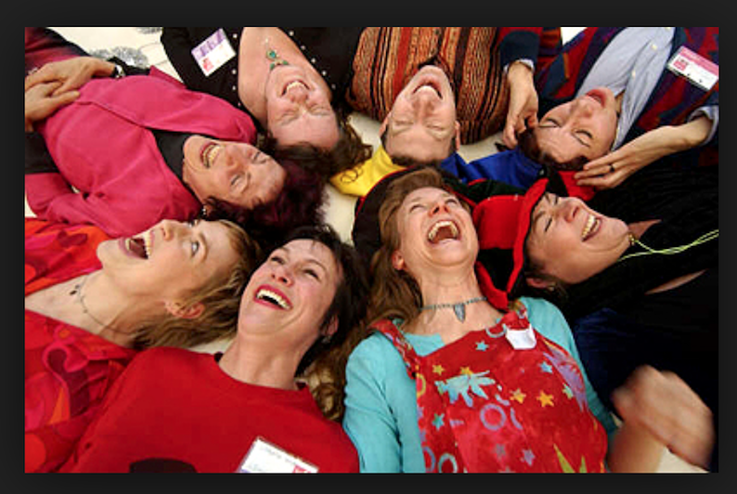

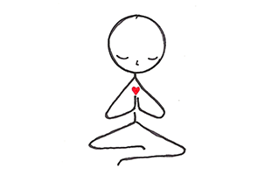
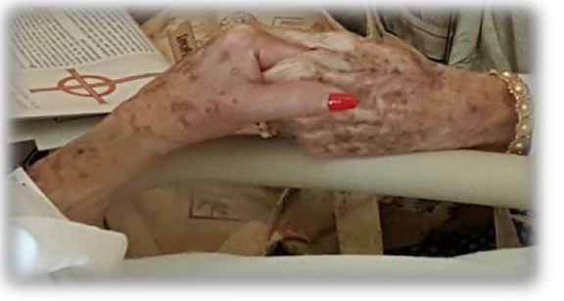
Emotions
Your feelings, intuition, and reactions
Skills to build your emotions:
  Laughter Therapy
  Express Gratitude
  Practice Forgiveness
  Cultivate Joy
Compassionate contemplation
  Reduces anxiety & depression
  Increases feelings of security, empathy, and love
  Anger and prejudice, e.g. extreme fundamentalist beliefs, can permanently damage brain
Notes:
Techniques: self soothing, ie rocking, humming, breathing, prayer, pausing
7basic emotions: Anger, Contempt, Fear, Disgust, Happiness, Sadness and Surprise

Slide 18
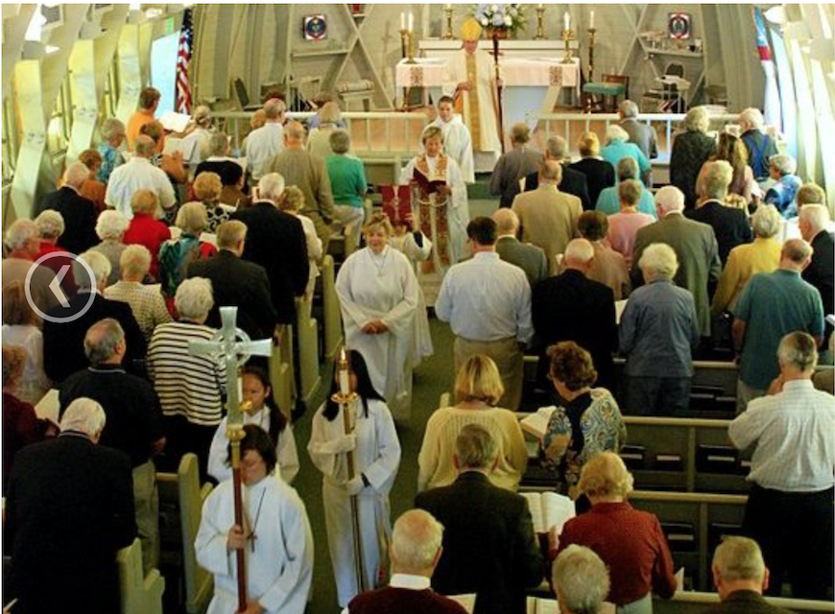
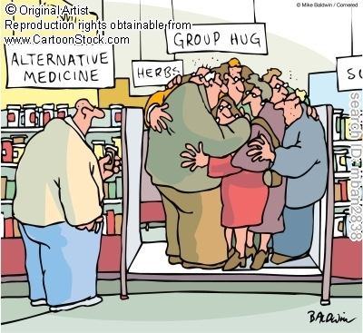
Community
Having meaningful ties
Making contributions
Being part of something bigger than you
A sense of belonging
Loneliness is significantly tied to negative health outcomes and Quality of Life
Skills to build your community source of health
  Vital Friendships
  Conversations
  Listening
  Volunteerism
Tending & Befriending:
Raises oxytocin, potentiated by opioids and estrogen
Inhibits naloxone, an opiate antagonist
Decreases SNS activity and cortisol release.
By contrast, testosterone enhances fight or flight response which stimulates SNS. (Taylor et al.)

Slide 19




Your Environment
Surroundings or conditions in which we live, work, & play impact your health, mood and behavior.
Skills to build your environmental source of health:
  Propagate places of beauty
  Advocate for your environment
  Grounding: Literally, connect to the earth
  Practice good stewardship

Slide 20







STRENGTHENING THE 7 SOURCES OF INDIVIDUAL HEALTH
Definition | Research Support | Sample EB-Skills
Life purpose is your WHY, what gives your life meaning, the reason you get out of bed in the morning. | Knowing and living your life purpose increases your life by 7 years and makes you happier and healthier. | Your Life Story Crucibles Volunteering You Lab
Body is the PHYSICAL SOH. Includes what you EAT and how and how much you MOVE and SLEEP. | Moving at lest 150 minutes a week increases lifespan. Better quality & quantity of food & sleep improves health. | Spine/Basic Movement Food is Medicine Healthy Sleep Habits Acupressure
Mind is the THINKING SOH. Includes your thoughts, sensations, and your ability to reason and focus. | Building mindfulness and awareness enhances neuroplasticity, brain size, chemistry and brain waves. | Meditation Biofeedback Relaxation Response Guided Imagery
Emotion is the FEELING SOH. Includes your intuition and reactions to what happens to you. | Building emotional SOH improves resiliency, stress management, happiness, and symptoms of chronic disease. | Forgiveness Gratitude Emotional Freedom Technique Positive Psychology
Creativity is the VITAL SOH. Includes spiritual believes, something greater than us & a sense of “common humanity”. | Connecting to your higher self improves quality of life, overall health, connection with others, and identifying your WHY. | Beliefs Drawing Journaling Ritual
Community is a SHARED EMOTIONAL SOH. Includes having meaningful ties & being part of one or more groups. | Being part of a community improves overall health, well-being, quality of life and longevity. | Vital Friendships Connection Compassion Training Communication & Conversation
Environment is a SHARED PHYSICAL SOH. Includes the conditions where you live, work, and play. | Environment, especially home and work spaces, impacts your health, mood and behavior. | Balance Environmental Triggers Changing a Habit Your Relationship with Money
Life Purpose
Body
Mind
Emotions
Creativity
Community
Environment
SOH = Source of Health

Slide 21
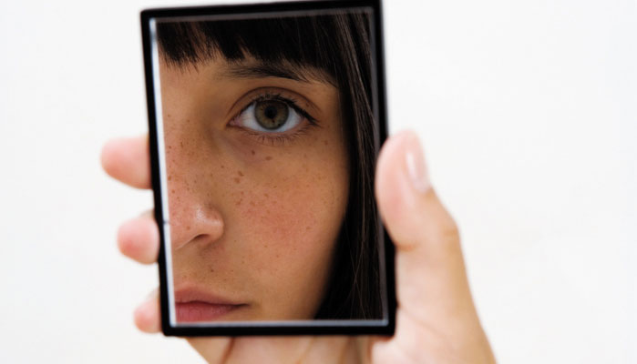
Self-care Starts with Self- Awareness
Notes:
Distribute card

Slide 22
Assess Your Sources of Health
SOH | MY RATING (1-10)
Purpose
Body
Mind
Creativity
Emotions
Community
Environment
Total + Divide by 7 =

Slide 23
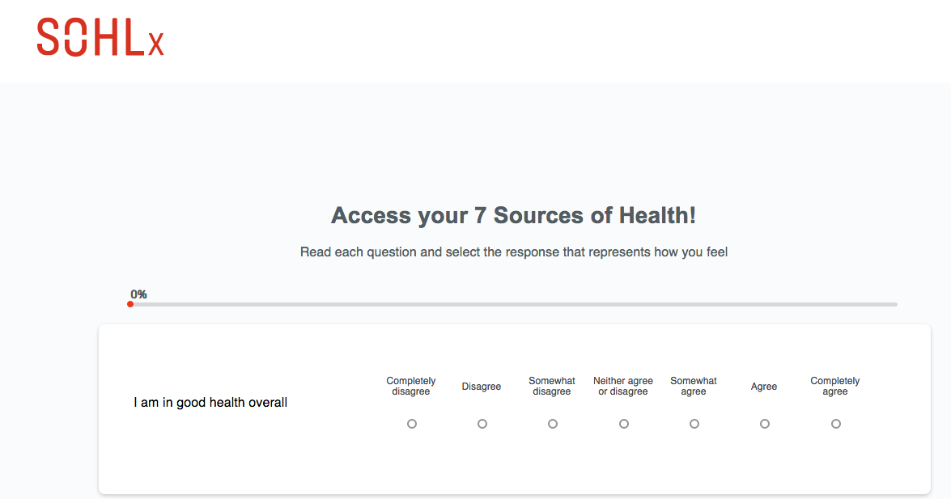
SOHLx Personalized Assessment
Website link: http://sohl.cruxlab.io/polls/ibm/

Slide 24
SOHLx Evidence-Based Self-care Skills Series (150+ practices)
Body Practices
Acupressure (3)
Food is medicine (3)
Sleep habits (3)
Progressive muscle relaxation (3)
Recharge: Find meaning
Spine movement (3)
Stand (3)
Mind Practices
Be aware (3)
Biofeedback
Autogenic training
Focus (3)
Guided imagery (3)
Life long learning (3)
Neurobics & memory training
Relaxation response (3)
Emotion Practices
Forgiveness (3)
Emotional freedom technique (3)
Gratitude
Self-hypnosis
Laughter
Positive psychology
Savor
Purpose Practices
Your WHY/Life Purpose (3)
Be Your Own Best Friend
BYOBF (3)
Crucibles (3)
Self-coaching (3)
Volunteering
YouLab (3)
Your life story (3)
Creativity Practices
Drawing (3)
Journaling (3)
Meditation (3)
Qi Gong (3)
Reframing (3)
Ritual (3)
Yoga (3)
Community Practices
Compassionate communication
Healthy conversations
Connection (3)
Listen (3)
Vital Friendships (3)
Belonging in community (3)
Compassion training (3)
Environment Practices
Balance, Personal & Professional
Changing a habit (3)
Your relationship with money (3)
Grounding (3)
Environmental triggers (3)
NEAT(Non-exercise activity thermogenesis)
Mess and stress
Notes:
Should we make copies of this slide to distribute?

Slide 25
So how is self-care sound Christian practice?
1. Scripture says so:
”…your body is a temple of the Holy Spirit within you, whom you have from God. You are not your own, for you were bought with a price. So glorify God in your body.” Corinthians 6:19-20
2. God made gave us the innate gift of self-care
“For no one ever hated his own flesh, but nourishes and cherishes it, just as Christ does the church…” Ephesians 5:29
3. Jesus modeled self-care:
He took time to meditate, he relied on friends, he ate and drank, he told stories, he prayed, he slept, and he moved.

Slide 26
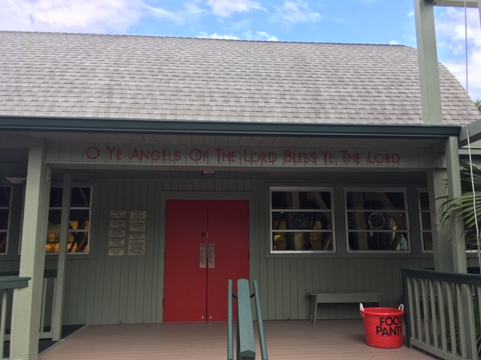
Which sources of health are used through your spiritual practice?
YOUR WHY
Body
Mind
Creativity
Emotions
Community
Environment
7 Sources of Health

Slide 27
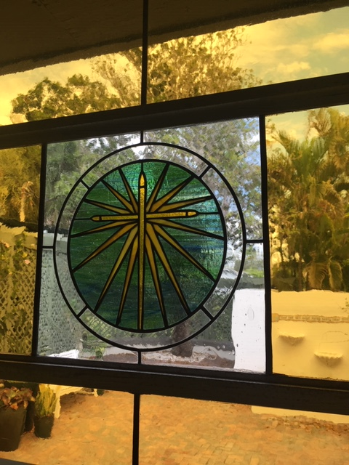
“An empty lantern provides no light. Self-care is the fuel that allows your light to shine brightly.”
– Unknown

Slide 28
Questions
Luann Fortune, PhD
lfortune@saybrook.edu

Slide 29
References
Bodenheimer, T., & Sinsky, C. (2014). From triple to quadruple aim: Care of the patient requires care of the provider. Annals of Family Medicine, 12, 573 – 576.
Ling, Q., Lin, M., & Wu, X. (2016). The trickle-down effect of servant leadership on frontline employee service behaviors and performances: A multilevel study of Chinese hotels. Tourism Management, 52, 341 – 368.
Hopkins, M. M., O’Neil, D. A., Fitzsimons, K., Bailen, P. L., & Stoller, J. K. (2011). Leadership and organization development in healthcare: Lessons from the Cleveland Clinic. Advances in Health Care Management,
Jiang, H., & Men, R. L. (2017). Creating an engaged workforce: The impact of authentic leadership, transparent organizational communication, and work-life enrichment. Communication Research, 44, 2, 225 – 243.
Mayer, D. M., Kuenzi, M., Greenbaum, R., Bardes, M., & Salvador, R. (2007). How does ethical leadership flow? Test of a trickle-down model. Organizational Behavior and Human Decision Processes, 108, 1 – 13.
McAlearney, A. S. (2009). Executive leadership development in U.S. healthcare systems. Journal of Healthcare Management, 55, 205 – 222.
McAlearney, A. S., & Pham, P. (2008). Executive leadership development in U.S. health systems: Exploring the evidence. Chicago, IL: American College of Healthcare Executives.
Prochaska, J. O., & Prochaska, J. M. (1999). Helping cure healthcare systems: Changing minds and behavior. Disease Management and Health Outcomes, 6, 335 – 341.
Scharmer, C. O. (2003). The blind spot of leadership: Presencing as a social technology of freedom. Retrieved from www.ottoscharmer.com/sites/default/files/2003_TheBlindSpot.pdf
Scott, G. (2009). The leader as coach: Effective coaching is key to patient satisfaction and quality care. Healthcare Executive, 24, (4), 40 – 43.
Shanafelt, T. D., Gorringe, G., Menaker, R., Sotrz, K. A., Reeves, D., Buskirk, S. J., …Swensen, S. J. (2015). Impact of organizational leadership on physician burnout and satisfaction. Mayo Clinic Proceedings, doi:
Shanafelt, T. D., Hasan, O., Dyrbye, L. N., Sinsky, C., Satele, D., Sloan, J., & West, C. P. (2015). Changes in burnout and satisfaction with work-life balance in physicians. Mayo Clinic Proceedings, 90, 12, 1600 – 1613.
Zenger, J., & Folkman, J. (2016). The trickle-down effect of good (and bad) leadership. Harvard Business Review (January 14, 2016).

Slide 30
Sample of research supporting 7 Sources of Health
The WHY, Life Purpose
  Hill, P., & Turiano, N. (2014). Purpose in life as a predictor of mortality across adulthood. Psychological Science, 25, 7, 1482 – 1486.
  Hill, P., Turiano, N., Mroczek, D. K., & Burrow, A. L. (2016). The value of a purposeful life: Sense of purpose predicts greater income and net worth. Journal of Research in Personality, 65, 38 – 42.
  Lewis, N. A., Toriano, N.A., Payne, B. R., & Hill, P. L. (2017). Purpose in life and cognitive functioning in adulthood. Aging, Neuropsychology and Cognition. 24, 6.
  Ko, H. J., Hooker, K., Geldof, G. J., & McAdams, D. P. (2016). Longitudinal purpose in life trajectories: Examining predictors in late midlife. Psychology of Aging, 31, 7, 693-698
  McKnight, P.E., & Kashdan, T.B. (2009). Purpose in life as a system that creates and sustains health and well-being: An integrative, testable theory. Review of General Psychology, 13, 242-251.
Body
  Research connecting nutrition, movement, and sleep quality of health and life and length of life
  Harter, J. K., & Gurley, V. F. (2008). Measuring Well-Being in the United States. Association for Psychological Science.
  Robertson, I. T., & Cooper, C. L. (2009). Full engagement: The integration of employee engagement and psychological well-being. Leadership & Organization Development Journal, 31, 324–336.

Slide 31
Sample of research supporting 7 Sources of Health
Mind
  Seminal work: Dusek, J. A., & Benson, H. (2009). Mind-body medicine: A model of the comparative clinical impact of the acute stress and relaxation responses. Minnesota Medicine, 92, 47 – 50.
  Extensive research on mind-body practices, funded by National Institutes of Health
  Shuck, B., & Reio, T. G. (2014). Employee engagement and well-being a moderation model and implications for practice. Journal of Leadership & Organizational Studies, 21(1), 43–58.
  Shuck, B., & Reio, T. G., (2014). Employee engagement and well-being: A Moderation model and implications for practice. Journal of Leadership and Organizational Studies, 21, 1.
Emotions
  Tischler, L., Biberman, J., & McKeage, R. (2002). Linking emotional intelligence, spirituality and workplace performance. Journal of Managerial Psychology, 17, 203 – 218.
  Naseem, K. (2017). Job stress and employee creativity: The mediating role of emotional intelligence. International Journal of Management Excellence, 9, 2.
  Wright, T. A., & Bonett, D. G. (2007). Job satisfaction and psychological well-being as non-additive predictors of workplace turnover. Journal of Management, 33, 141–160.
  Truss, C., Shantz, A., Soane, E., Alfes, K., & Delbridge, R. (2013). Employee engagement, organisational performance and individual well-being: exploring the evidence, developing the theory. International Journal of Human Resource Management, 14.

Slide 32
Sample of research supporting 7 Sources of Health
Creativity, Spirituality
  Bowen, M. G., Ferris, G. R., & Kolodinsky, R. W. (2010). Political skill, servant leadership, and workplace spirituality in the creation of effective work environments in R. A. Giacalone and C. L. Jurkiewicz (Eds.), Handbook of workplace spiritualty and organizational performance (pp. 126 – 142). Armonk, NY: M. E. Sharpe.
  Daniel, J. L. (2010). The effect of workplace spirituality on team effectiveness. Journal of Management Development, 29, 442 – 456.
  Karkas, F. (2009). Spirituality and performance in organizations: A literature review. Journal of Business Ethics, 94, 89 – 106.
  Mitroff, I. I., & Denton, E. A. (1992). A study of spirituality in the workplace. Sloan Management Review, 3, 83 – 92.
  Stuckey, H. L., & Nobel, J. (2010). The connection between art, healing, and public health: A review of current literature. American journal of public health, 100(2), 254-263.
  Van Cappellen, P., Way, B. M., Isgett, S. F., & Fredrickson, B. L. (2016). Effects of oxytocin administration on spirituality and emotional responses to meditation. Social Cognitive and Affective Neuroscience, 11(10), 1579-1587.
Community
  Harter, J., & Arora, R. (2008, June 5). Social time crucial to daily emotional well-being in U.S. Washington, DC: Gallup Press.
  Milliken, F. J., Schipani, C. A., Sichara, N. D., & Prado, A. M. (2015). Linking workplace practices to community engagement: The case for encouraging employee voice. Academy of Management, 29, 4.
Environment
  Gallup-Healthways-ShareCare. (2017). State of American Well-Being: Active Living Environment in US Communities. Franklin, TN: Healthways.
  The Gallup Organization. (2007). The state of global well-being. New York: Gallup.

